Slide 1
CMSC204
Kartchner
V(StateGraph) = {Oregon, Alaska, Texas, Hawaii, Vermont, NewYork, California}
E(StateGraph) = {(Alaska, Oregon), (Hawaii, Alaska), (Hawaii, Texas), (Texas, Hawaii), (Hawaii, California), (Hawaii, New York), (Texas, Vermont), (Vermont, California), (Vermont, Alaska)}
1. Draw the StateGraph
Alaska
Vermont
Oregon
New York
California
Texas
Hawaii

Slide 2
a. Show the adjacency matrix that would describe the edges in the graph. Store the vertices in alphabetical order
States
Alaska
California
Hawaii
New York
Oregon
Texas
Vermont
Alaska
California
Hawaii
New York
Oregon
Texas
Vermont
0 0 0 0 1 0 0
0 0 0 0 0 0 0
1 1 1 1 0 1 0
0 0 0 0 0 0 0
0 0 0 0 0 0 0
0 0 1 0 0 0 1
1 1 0 0 0 0 0
3. b. Show the adjacency lists
that would describe the edges in the graph
Alaska → {Oregon}
California → {}
Hawaii → {Alaska,Texas,Califronia,New Yrok}
New York → {}
Oregon → {}
Texas → {Hawaii,Vermont}
Vermont → {California,Alaska}

Slide 3
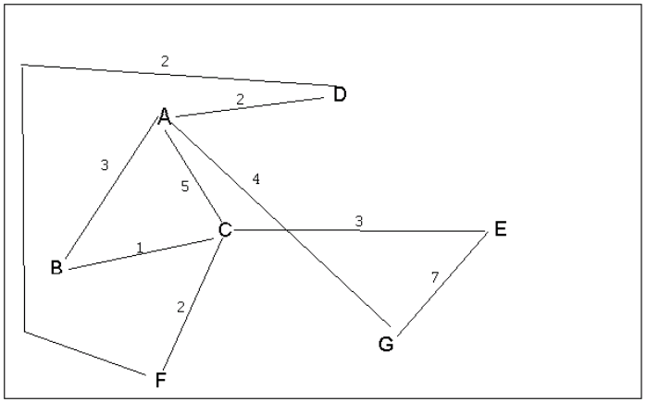
4 a. Which of the following lists the graph nodes in depth first order beginning with E?
A) E, G, F, C, D, B, A
B) G, A, E, C, B, F, D
C) E, G, A, D, F, C, B
D) E, C, F, B, A, D, G
4 b. Which of the following lists the graph nodes in breadth first order beginning at F?
A) F, C, D, A, B, E, G
B) F, D, C, A, B, C, G
C) F, C, D, B, G, A, E
D) a, b, and c are all breadth first traversals

Slide 4
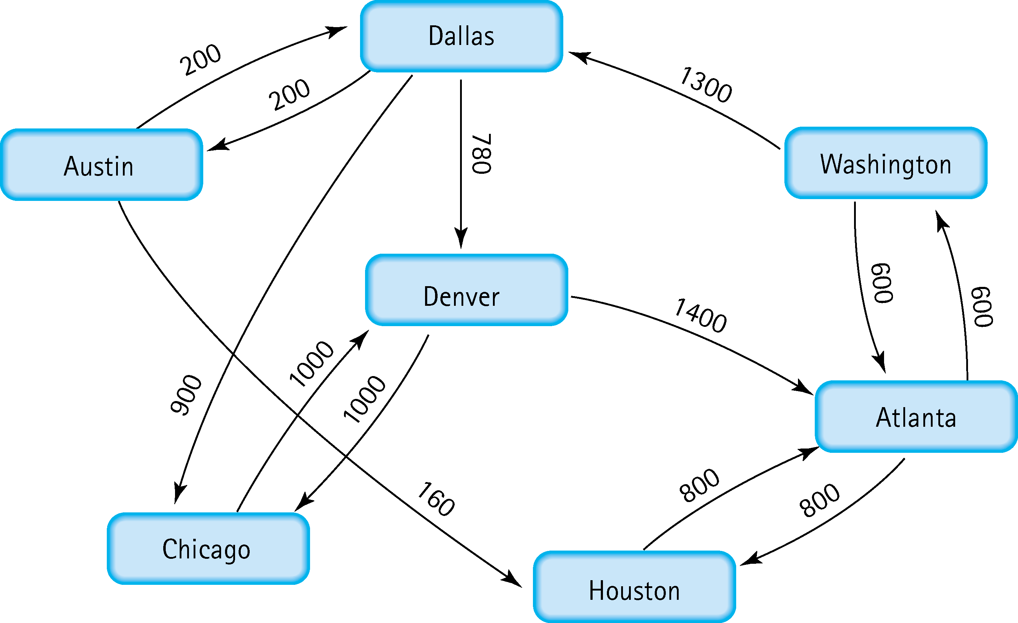
5. Find the shortest distance from Atlanta to every other city
600
Atlanta
Washington
Atlanta
800
Houston
1900
Atlanta
Dallas
Atlanta -> Washingston -> Dallas
2100
Atlanta
Austin
Atlanta -> Washingston -> Dallas -> Austin
2680
Atlanta
Denver
Atlanta -> Washingston -> Dallas -> Denver
2900
Atlanta
Chicago
Atlanta -> Washingston -> Dallas -> Chicago

Slide 5
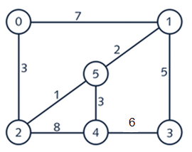
6. Find the minimal spanning tree using Prim’s algorithm. Use
0 as the source vertex . Show the steps.
Step 1. )
V(T) = {0}
E(T) = {}
N = {1,2,3,4,5}
Step 5. )
V(T) = {0,1,2,4,5}
E(T) = {(0,2) , (2,5), (5,1), (5,4)}
N = {3}
Step 5. )
V(T) = {0,1,2,3,4,5}
E(T) = {(0,2) , (2,5), (5,1), (5,4), (1,3)}
N = {}
Step 2. )
V(T) = {0,2}
E(T) = {(0,2)}
N = {1,3,4,5}
Total Weight = 14
Step 3. )
V(T) = {0,2,5}
E(T) = {(0,2) , (2,5)}
N = {1,3,4}
Step 4. )
V(T) = {0,1,2,5}
E(T) = {(0,2) , (2,5), (5,1)}
N = {3,4}

Slide 6
7. Find the minimal spanning tree using Kruskal’s algorithm.
Show the weights in order and the steps.
Step 1) Edges and weights
0-1 (7)
0-2 (3)
1-3 (5)
1-5 (2)
2-5 (1)
2-4 (8)
3-4 (6)
4-5 (3)
Step 2) Order by weight
2-5 (1)
1-5 (2)
0-2 (3)
4-5 (3)
1-3 (5)
3-4 (6)
0-1 (7)
2-4 (8)
Step 3) Build MST
V = {2,5}
2-5 (1)
1-5 (2)
0-2 (3)
4-5 (3)
1-3 (5)
3-4 (6)
0-1 (7)
2-4 (8)
Continued) Build MST
V = {1,2,5}
2-5 (1)
1-5 (2)
0-2 (3)
4-5 (3)
1-3 (5)
3-4 (6)
0-1 (7)
2-4 (8)
Continued) Build MST
V = {0,1,2,5}
2-5 (1)
1-5 (2)
0-2 (3)
4-5 (3)
1-3 (5)
3-4 (6)
0-1 (7)
2-4 (8)
Continued) Build MST
V = {0,1,2,4,5}
2-5 (1)
1-5 (2)
0-2 (3)
4-5 (3)
1-3 (5)
3-4 (6)
0-1 (7)
2-4 (8)
Continued) Build MST
V = {0,1,2,3,4,5}
2-5 (1)
1-5 (2)
0-2 (3)
4-5 (3)
1-3 (5)
3-4 (6)
0-1 (7)
2-4 (8)
Step 4) evaluate
V = {0,1,2,3,4,5}
Edges:
2-5 (1)
1-5 (2)
0-2 (3)
4-5 (3)
1-3 (5)
1+2+3+3+5 = 14
Weight: 14

Slide 7
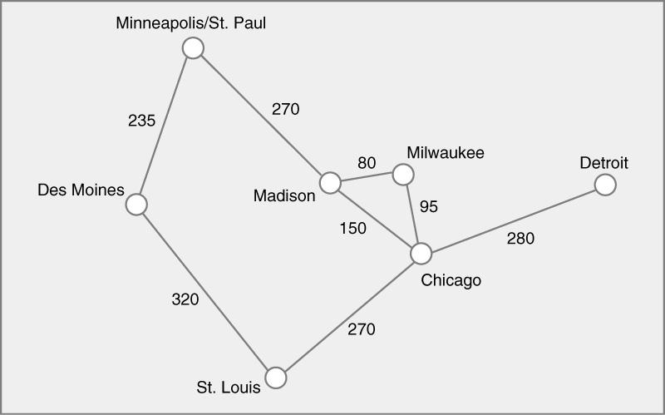
8. Find the minimal spanning tree using the algorithm you prefer. Use
Minneapolis/St. Paul as the source vertex
Using Prims Algorithm
Step 1) List of Edges and weights
Minneapolis – Des Moines (235)
Minneapolis – Madison (270)
Des Moines – St. Louis (320)
St.Louis – Chicago (270)
Madison – Miwaukee (80)
Madison – Chicago (150)
Milwaukee – Chicago (95)
Chicago – Detroit (280)
Using Prims Algorithm
Step 2 Start)
V(T) = {Minneapolis}
E(T) = {}
Step 2.1 Continued)
V(T) = {Minneapolis,Des Moines}
E(T) = {(Minneapolis,Des Moines), }
Step 2.2 Continued)
V(T) = {Minneapolis, Des Moines, Madison}
E(T) = {(Minneapolis,Des Moines), (Minneapolis,Madison)}
Step 2.3 Continued)
V(T) = {Minneapolis, Des Moines, Madison,Milwaukee}
E(T) = {(Minneapolis,Des Moines), (Minneapolis,Madison),(Madison,Milwaukee)}
Step 2.4 Continued)
V(T) = {Minneapolis, Des Moines, Madison,Milwaukee,Chicago}
E(T) = {(Minneapolis,Des Moines), (Minneapolis,Madison),(Madison,Milwaukee),
(Milwaukee,Chicago)}
Step 2.5 Continued)
V(T) = {Minneapolis, Des Moines, Madison,Milwaukee,Chicago,St.Louis}
E(T) = {(Minneapolis,Des Moines), (Minneapolis,Madison),(Madison,Milwaukee),
(Milwaukee,Chicago),(Chicago,St.Louis)}
Step 2.6 Final)
V(T) = {Minneapolis, Des Moines, Madison,Milwaukee,Chicago,St.Louis,Detroit}
E(T) = {(Minneapolis,Des Moines), (Minneapolis,Madison),(Madison,Milwaukee),
(Milwaukee,Chicago),(Chicago,St.Louis),(Chicago,Detroit)}
Step 4 MST)
Edges:
Minneapolis – Des Moines (235)
Minneapolis – Madison (270)
Madison – Milwaukee (80)
Milwaukee – Chicago (95)
Chicago – St.Louis (270)
Chicago – Detroit (280)
Step 3 Evaluate Weights)
Weight = 1230

Slide 8
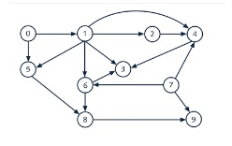
9. List the nodes of the graph in a breadth first topological ordering. Show the
steps using arrays predCount, topologicalOrder and a queue
predCount
0 | 0 | 0 | 1 | 1 | 0 | 0 | 0 | 2 | 1
topologicalOrder
0 | 7 | 1 | 2
Queue: [5,6]
predCount
0 | 1 | 1 | 2 | 4 | 2 | 2 | 0 | 2 | 2
predCount
0 | 0 | 0 | 1 | 1 | 0 | 0 | 0 | 1 | 1
topologicalOrder
topologicalOrder
0 | 7 | 1 | 2 | 5
Queue: [0,7]
Queue: [6,3,8]
predCount
0 | 0 | 1 | 2 | 4 | 2 | 2 | 0 | 2 | 2
predCount
0 | 0 | 0 | 0 | 1 | 0 | 0 | 0 | 0 | 1
topologicalOrder
0
topologicalOrder
0 | 7 | 1 | 2 | 5 | 6
Queue: [7,1]
Queue: [3,8]
predCount
0 | 0 | 1 | 2 | 3 | 1 | 1 | 0 | 2 | 1
predCount
0 | 0 | 0 | 0 | 0 | 0 | 0 | 0 | 0 | 1
topologicalOrder
0 | 7
topologicalOrder
0 | 7 | 1 | 2 | 5 | 6 | 3
Queue: [1]
Queue: [8,4,9]
predCount
0 | 0 | 0 | 1 | 2 | 0 | 0 | 0 | 2 | 1
predCount
0 | 0 | 0 | 0 | 0 | 0 | 0 | 0 | 0 | 0
topologicalOrder
0 | 7 | 1
topologicalOrder
0 | 7 | 1 | 2 | 5 | 6 | 3 | 8 | 4 | 9
Queue: [2,5,6]
Queue:

Slide 9

10. List the nodes of the graph in a breadth first topological ordering.
Breadth First Topological Order-
Start
Discrete Math
Programming 1
Programming 2
Computer Organization
Algorithms
High-Level-Languages
Operating System
Theory Of Compuation
Compilers
Senior Seminar
End

